Slide 1
Matrix Algebra
MATRIX FACTORIZATIONS

Slide 2
MATRIX FACTORIZATIONS
A factorization of a matrix A is an equation that expresses A as a product of two or more matrices.
Whereas matrix multiplication involves a synthesis of data (combining the effects of two or more linear transformations into a single matrix), matrix factorization is an analysis of data.

Slide 3
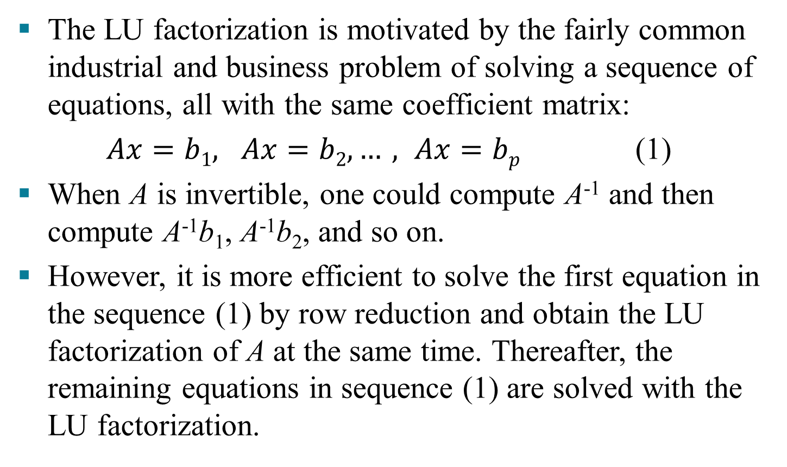
THE LU FACTORIZATION
The LU factorization is motivated by the fairly common industrial and business problem of solving a sequence of equations, all with the same coefficient matrix:
$Ax=b1, Ax=b2, …, Ax=bp$ (1)
When A is invertible, one could compute A⁻¹ and then compute A⁻¹b₁, A⁻¹b₂, and so on.
However, it is more efficient to solve the first equation in the sequence (1) by row reduction and obtain the LU factorization of A at the same time. Thereafter, the remaining equations in sequence (1) are solved with the LU factorization.

Slide 4
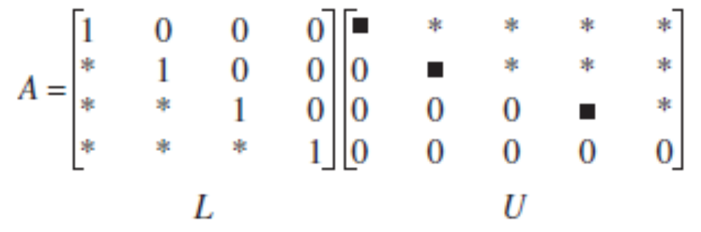
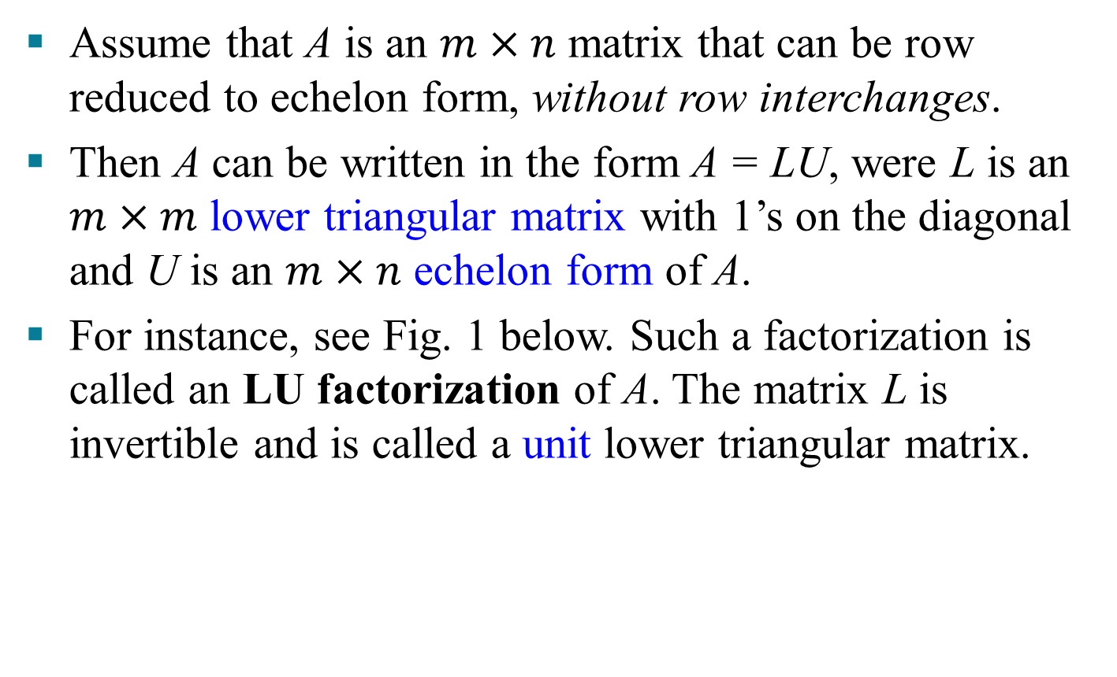
THE LU FACTORIZATION
Assume that A is an $m×n$ matrix that can be row reduced to echelon form, without row interchanges.
Then A can be written in the form A = LU, were L is an $m×m$ lower triangular matrix with 1’s on the diagonal and U is an $m×n$ echelon form of A.
For instance, see Fig. 1 below. Such a factorization is called an LU factorization of A. The matrix L is invertible and is called a unit lower triangular matrix.

Slide 5
THE LU FACTORIZATION
Why is LU factorization useful?
When A = LU, the equation Ax = b can be written as L(Ux) = b.
Writing y for Ux, we can find x by solving the pair of equations
First solve Ly = b for y, and then solve Ux = y for x. See Fig. 2 on the next slide. Each equation is easy to solve because L and U are triangular.
Ly = b
Ux = y

Slide 6
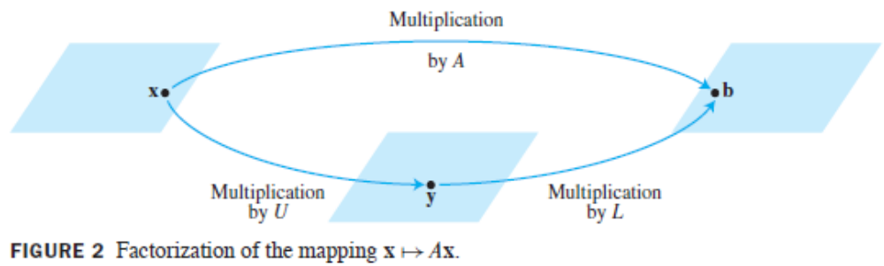
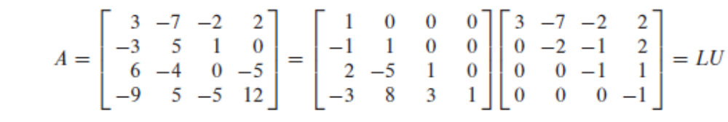
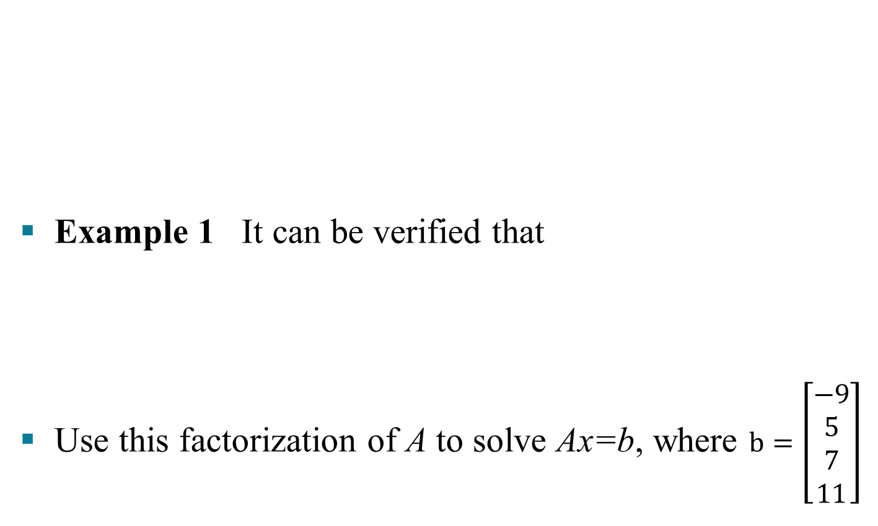
THE LU FACTORIZATION
Example 1 It can be verified that
Use this factorization of A to solve Ax=b, where $b=\left[\begin{aligned}−9 \\ 5 \\ 7 \\ 11\end{aligned}\right]$

Slide 7
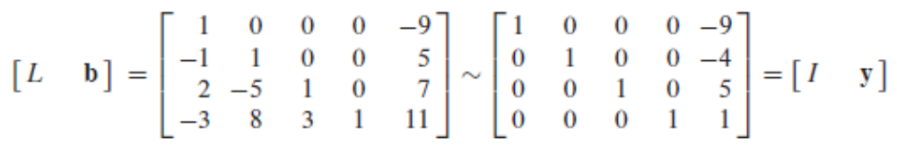
THE LU FACTORIZATION
Solution The solution of Ly = b needs only 6 multiplications and 6 additions, because the arithmetic takes place only in column 5.
Then, for Ux = y, the “backward” phase of row reduction requires 4 divisions, 6 multiplications, and 6 additions.

Slide 8
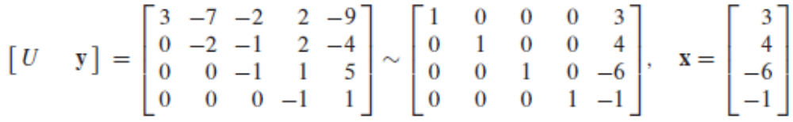
THE LU FACTORIZATION
For instance, creating the zeros in column 4 of [U y] requires 1 division in row 4 and 3 multiplication-addition pairs to add multiples of row 4 to the rows above.
To find x requires 28 arithmetic operations, or “flops” (floating point operations), excluding the cost of finding L and U. In contrast, row reduction of [A b] to [I x] takes 62 operations.

Slide 9
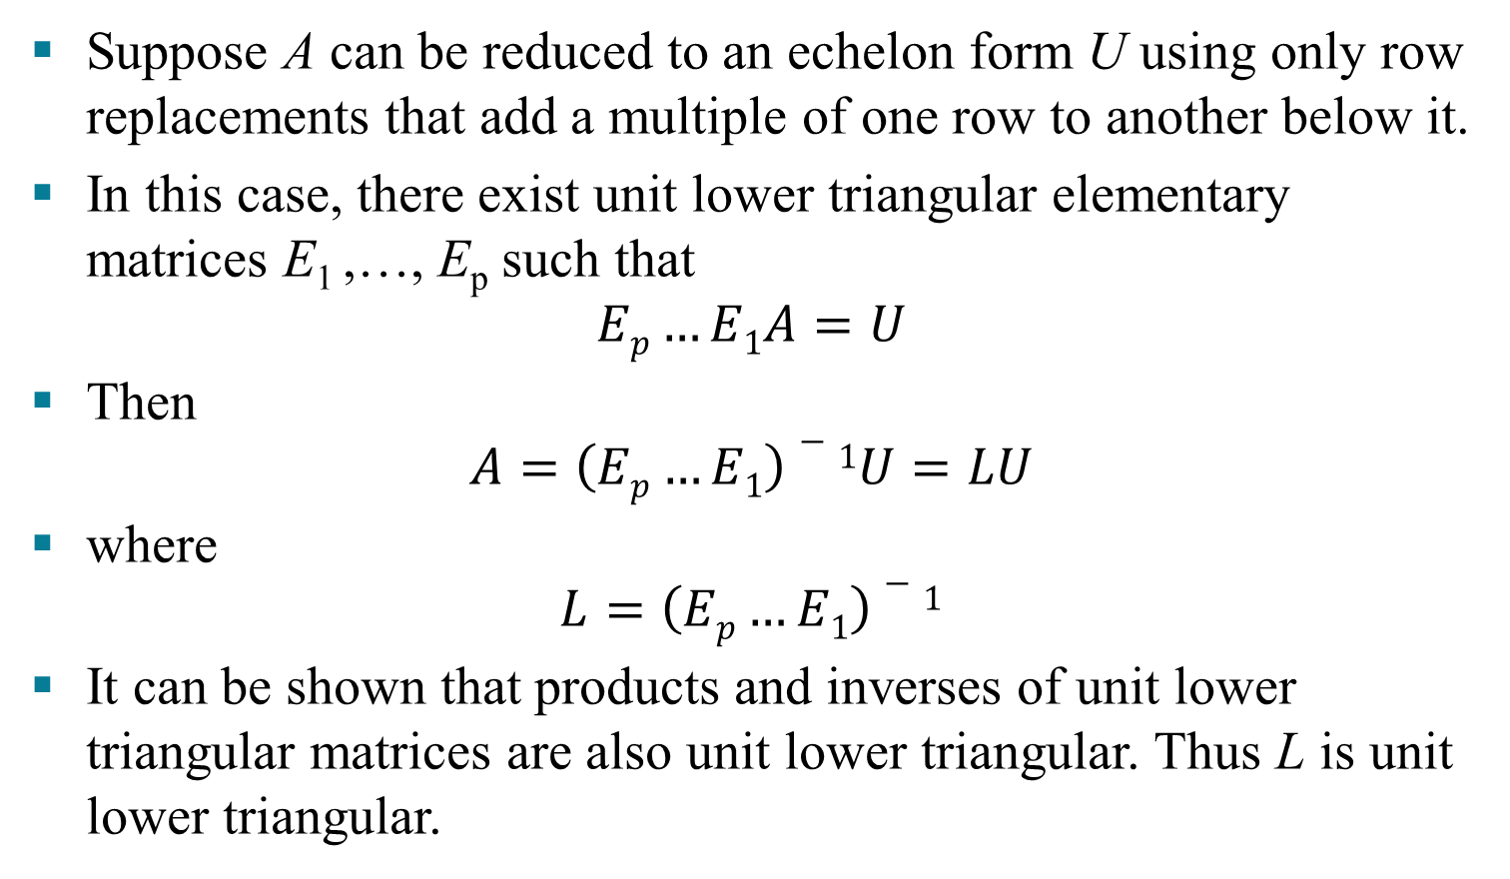
AN LU FACTORIZATION ALGORITHM
Suppose A can be reduced to an echelon form U using only row replacements that add a multiple of one row to another below it.
In this case, there exist unit lower triangular elementary matrices E₁ ,…, E_{p} such that
$$Ep…E1A=U$$
Then
$$A=\left(Ep…E1\right)−1U=LU$$
where
$$L=\left(Ep…E1\right)−1$$
It can be shown that products and inverses of unit lower triangular matrices are also unit lower triangular. Thus L is unit lower triangular.
(3)
(4)

Slide 10
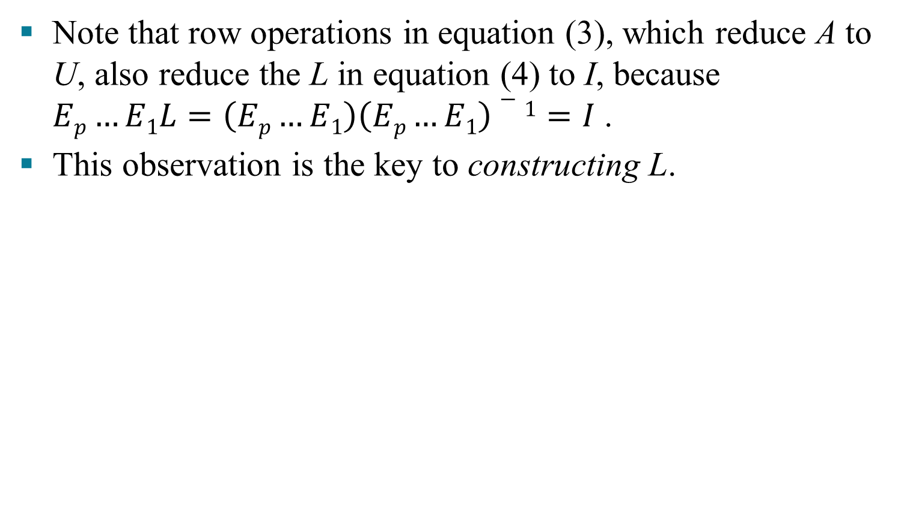
AN LU FACTORIZATION ALGORITHM
Note that row operations in equation (3), which reduce A to U, also reduce the L in equation (4) to I, because $Ep…E1L=\left(Ep…E1\right)\left(Ep…E1\right)−1=I$ .
This observation is the key to constructing L.
Algorithm for an LU Factorization
Reduce A to an echelon form U by a sequence of row replacement operations, if possible.
Place entries in L such that the same sequence of row operations reduces L to I.

Slide 11
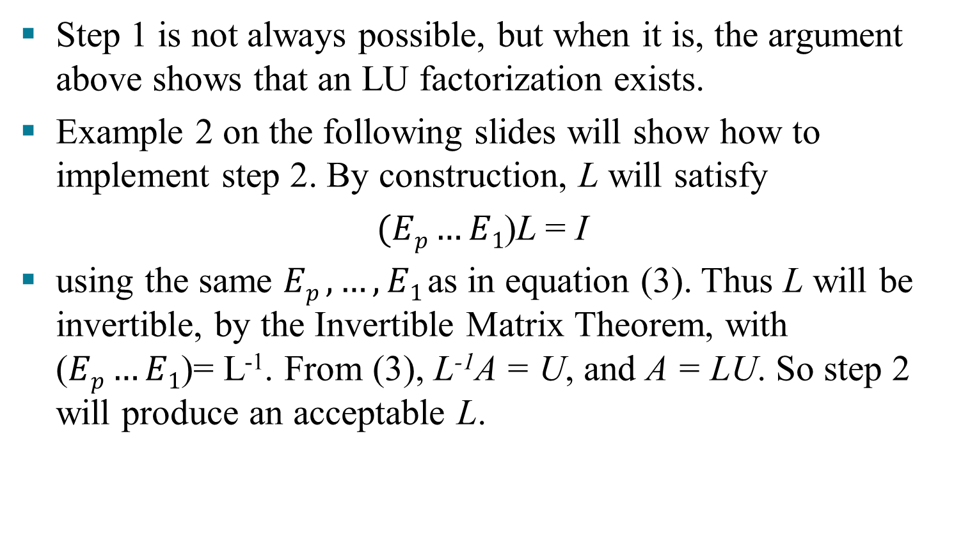
AN LU FACTORIZATION ALGORITHM
Step 1 is not always possible, but when it is, the argument above shows that an LU factorization exists.
Example 2 on the following slides will show how to implement step 2. By construction, L will satisfy
$(Ep…E1$)L = I
using the same $Ep ,…,E1$as in equation (3). Thus L will be invertible, by the Invertible Matrix Theorem, with ($Ep…E1$)= L⁻¹. From (3), L⁻¹A = U, and A = LU. So step 2 will produce an acceptable L.

Slide 12
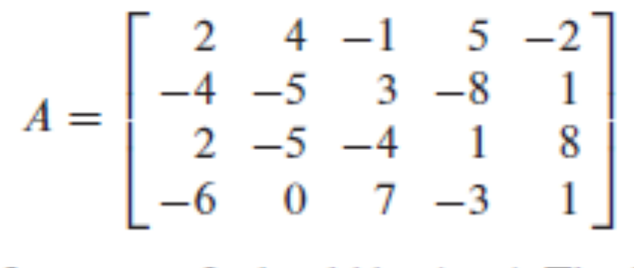
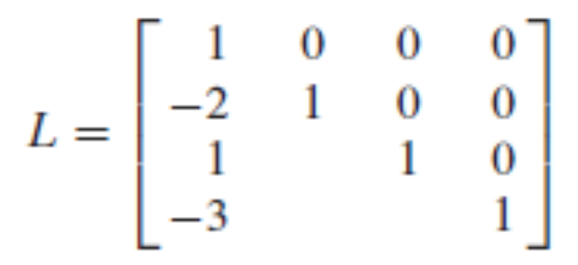
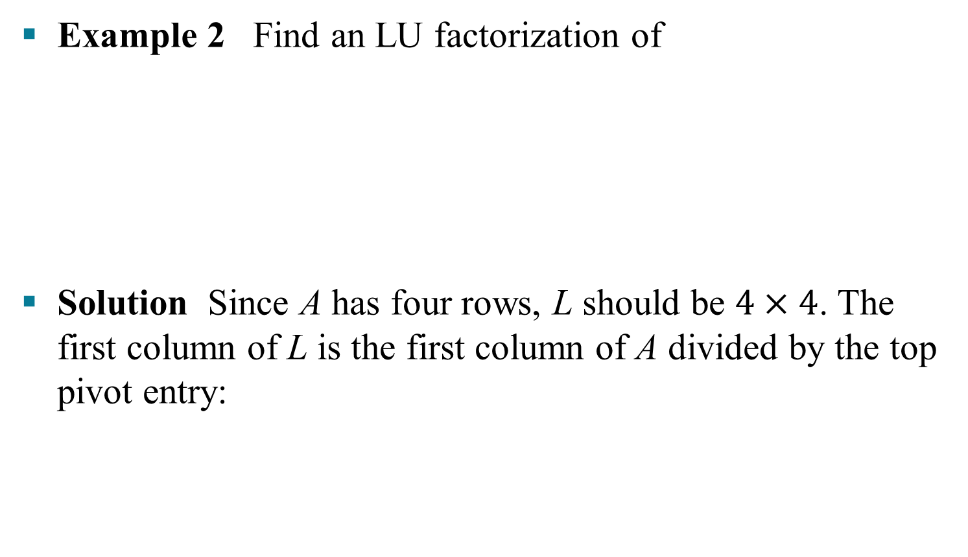
AN LU FACTORIZATION ALGORITHM
Example 2 Find an LU factorization of
Solution Since A has four rows, L should be $4×4$. The first column of L is the first column of A divided by the top pivot entry:

Slide 13
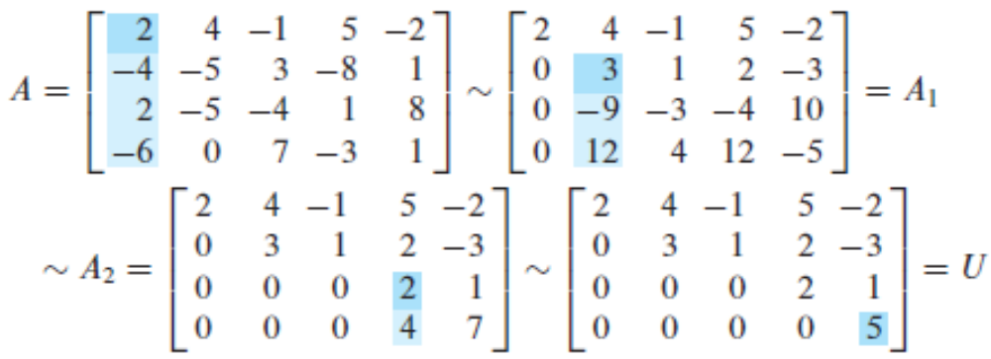
AN LU FACTORIZATION ALGORITHM
Compare the first columns of A and L. The row operations that create zeros in the first column of A will also create zeros in the first column of L.
To make this same correspondence of row operations on A hold for the rest of L, watch a row reduction of A to an echelon form U. That is, highlight the entries in each matrix that are used to determine the sequence of row operations that transform A into U.
(5)

Slide 14
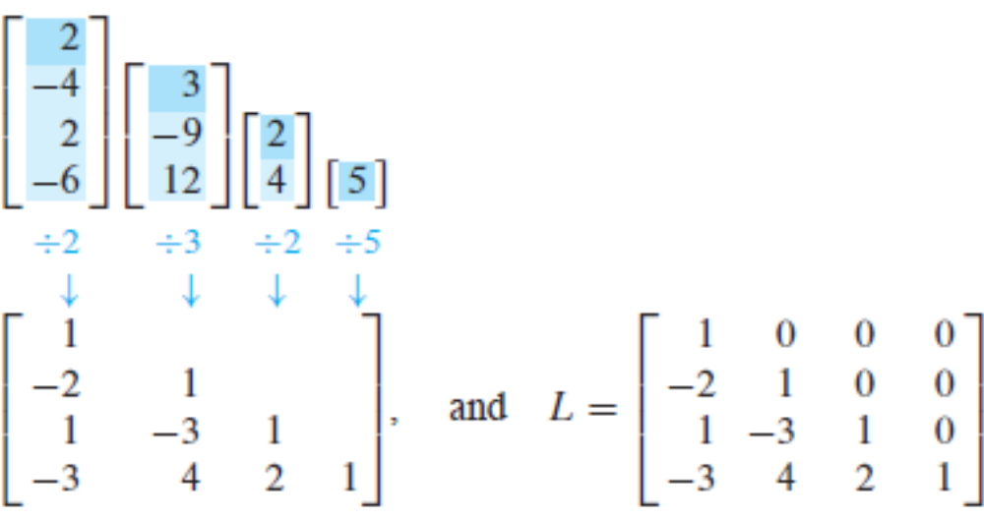
AN LU FACTORIZATION ALGORITHM
The highlighted entries above determine the row reduction of A to U. At each pivot column, divide the highlighted entries by the pivot and place the result into L:
An easy calculation verifies that this L and U satisfy LU = A.

